Slide 1
ICS 第0xa次小班课
2021-11-30

Slide 2
Virtualization of CPU #1/5
Only a handful of CPUs, but many tens of processes. How to share the physical CPU among many jobs running seemingly at the same time?
Time-sharing to rescue.
Performance: a light overhead is desired
Control: OS should be in charge of the system, to protect the use process from doing any harm and to allocate the limited resource (e.g. memory, time, computation, etc.) “fairly” among processes.
Virtual memory to feign private address space.
Basic idea: Limited Direct Execution
User mode vs. kernel mode
Code that runs in user mode is limited in what it can do. In contrast, in kernel mode, code can do whatever it likes. Processes must solicit help from the kernel via system calls.
The constrained instruction set in user mode must be supported by the hardware. Software designer (typically OS designer) implements the system call interface.
Cooperative & non-cooperative scheduling (Cont.)

Slide 3
Virtualization of CPU #2/5
Basic idea: Limited Direct Execution
User mode vs. kernel mode
Cooperative & non-cooperative scheduling
In cooperative scheduling, kernel trusts the process to behave reasonably by yielding itself from time to time, typically via invoking system calls and via errors.
In non-cooperative scheduling, kernel interrupts the execution of a process forcefully when the process runs for too long a time. This is implemented by a timer interrupt.
Implementation issues:
System calls:
Save & restore context:
should memory and other program-invisible states be saved?
Should registers, condition code and PC be saved?
Where should it be saved? Say, in the user stack?
Calling conventions:
Which system call to invoke? Where are its arguments?

Slide 4
Virtualization of CPU #3/5
Implementation issues:
Scheduling:
Context switch:
should memory and other program-invisible states be saved?
Should registers, condition code and PC be saved?
Where should it be saved? Say, in the user stack?
How to restore the context of the new process?
Which process to switch to?
Not covered in this course. Generally known as the scheduling policy or the scheduling algorithm.

Slide 5
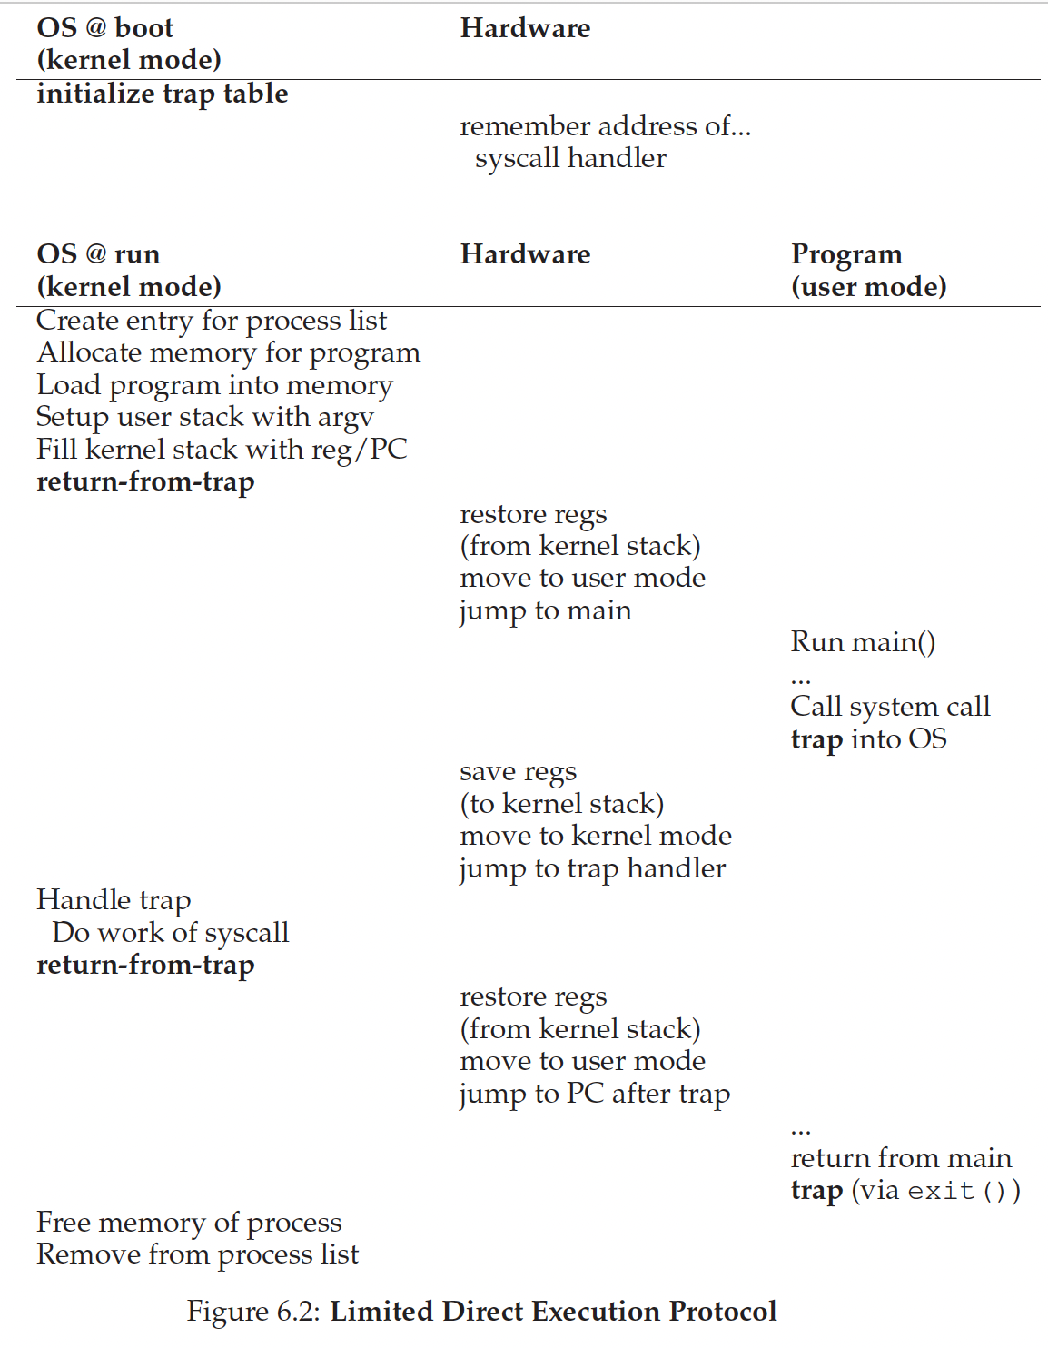
Virtualization of CPU #4/5
time

Slide 6
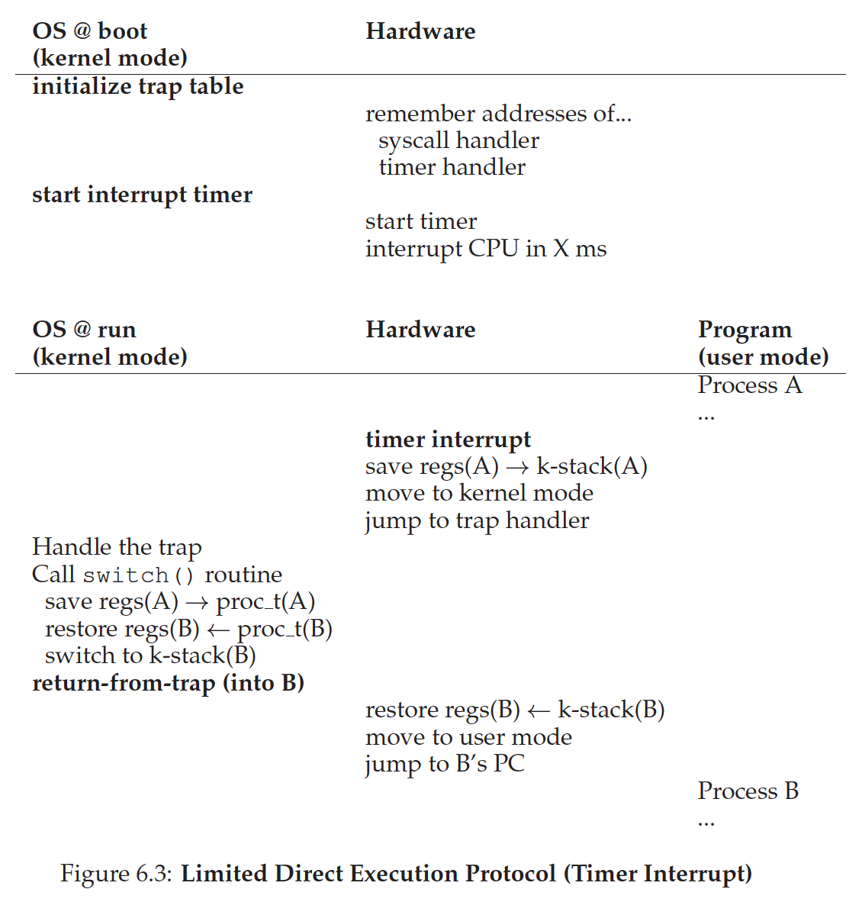
Virtualization of CPU #5/5
time

Slide 7
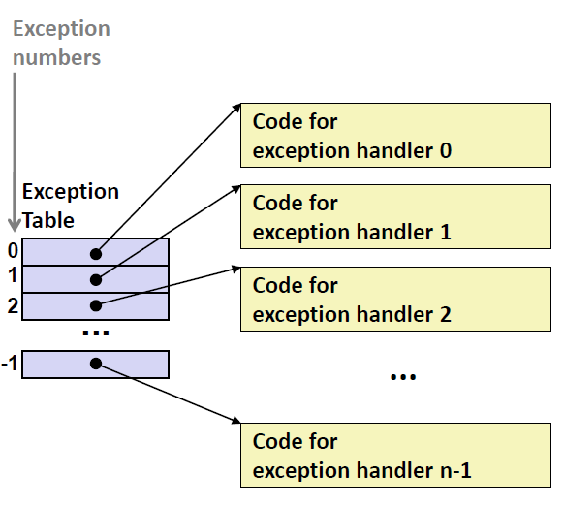
Process must be aware of certain system-wide events
This is what exactly exceptions do!
It does not mean something bad happens. It is just that something system-wide noteworthy happened.
Once an exception happens, CPU hardware saves some context and fetched the corresponding handler by using the exception number to index into the exception table, which is configured during booting. [A privileged operation.]
After that it is showtime for the software! If the exception is recovered, it resumes the original process.
What nippy interplay between hardware and software :)

Slide 8
Do you want to read the exception table?
Oops, OS designer may not offer you such an interface.
But when you write an OS, it is visible to you hahaha.
But as least you can see the how the exception number corresponds to the exception from docs.

Slide 9
Trap (mostly system calls): Intentional, generally benign
Your program solicits help from kernel.
IO requests. Access process info from Process Control Block (PCB). Terminate current process (since it gives the control away). Process control (fork, execve, waitpid, etc.) and so on.
A special calling inst is required. [Raise the privilege level] In x86, this is syscall.
A special return inst is required. [Restore the context (namely registers, but not only general-purpose ones). Degrade the privilege level.] In x86, this is sysret.
System call handler is registered in the exception table. Once a syscall is triggered, system call handler (or referred to as the entry point) is invoked. It in turn calls the specific system call handlers according to the system call number pushed down the stack.
System call table is also configured during booting.

Slide 10
Do you want to read the system call table?
Oops, OS designer may not offer you such an interface.
Why should it use system call number in lieu of the pointer to the handler?
Intentional transparency of critical kernel information to the user process.
But as least you can see how the system call number corresponds to the system calls.
Other traps: debug, breakpoints and overflow (when INTO is executed and OF is on)
/* asm/unistd_64.h */
// About 350 system calls in total
#ifndef _ASM_X86_UNISTD_64_H
#define _ASM_X86_UNISTD_64_H 1
#define __NR_read 0
#define __NR_write 1
#define __NR_open 2
#define __NR_close 3
#define __NR_stat 4
#define __NR_fstat 5
...
#define __NR_faccessat2 439
#endif /* _ASM_X86_UNISTD_64_H */

Slide 11
#include <string.h>
#include <unistd.h>
void foo(const char *ptr, size_t len){
asm("movq %rsi, %rdx; \
movq %rdi, %rsi; \
movq $1, %rax; \
movq $1, %rdi; \
syscall");
return;
}
void bar(const char *ptr, size_t len){
write(1, ptr, len);
return;
}
int main(){
const char p[] = "Hello World!\n";
foo(p, strlen(p));
bar(p, strlen(p));
}
// Linux上write的系统调用号为1，放在%rax
// 第二个参数%rdi(write的第一个参数)表明输出文件描述符，我们选择标准输出1
// 第三个参数%rsi表明缓冲区，根据foo的参数列表和x86-64传输惯例，在foo被调用时存放在%rdi中
// 第四个参数%rdx表明写的长度，根据foo的参数列表和x86-64传输惯例，在foo被调用时存放在%rsi中

Slide 12
Interrupts: Asynchronous
IO interrupts: most often, DMA, and access to other peripheral device.
Timer interrupts: scheduling, or user timer.
Faults: General protection error, might recoverable
Memory permission violation: page faults, copy on write, write to a read-only area, illegal access, etc.
Privilege level violation.
Operational exception: Divide by 0, etc.
Aborts: Severe hardware errors or software bugs, unrecoverable
Double fault: an exception occurs while the CPU is trying to call an exception handler.
Triple fault: a triple fault occurs when an exception is generated when attempt to call the double fault exception handler. It results in the processor resetting.
Machine check: a fatal hardware error

Slide 13
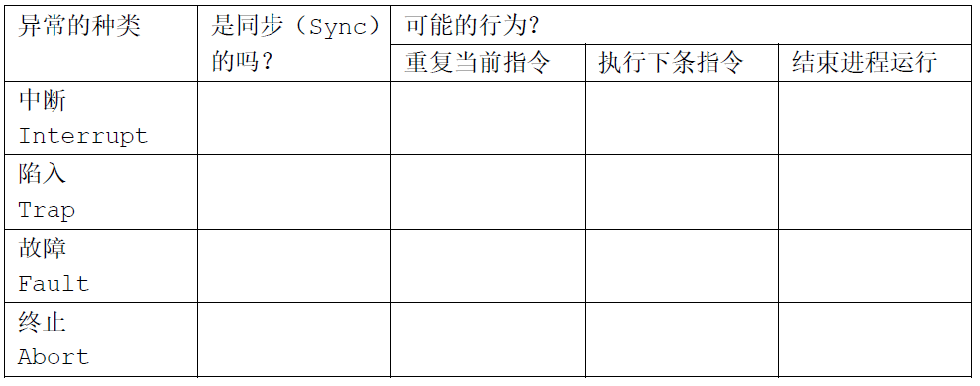
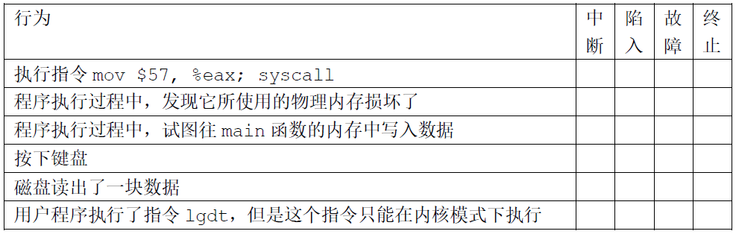
√
√
√
√
√
√
√
√
√
√
√
√
√
√

Slide 14
You should tell the difference between a program and a process!
Process control
After fork, the scheduling order of parent and its child is invisible to the user process. Your program shall not make any assumptions on it to work properly!
After fork, parent and its child has their own address space. They no longer affect each other!
After execve, a new program is loaded, as if it is a new process.
On exit, the process is just terminated and becomes a zombie. That is, the memory and file resources are all destructed. It only takes up an entry in the PCB. Why is it necessary?

Slide 15
Why zombie process is necessary?
To put it simple: For parent to know the exit status and resource usage of its children.
One more thing to bear in mind: If the parent process never calls wait(), then the child process is reparented to the init process when the parent process dies, and init will wait() for the child.

Slide 16
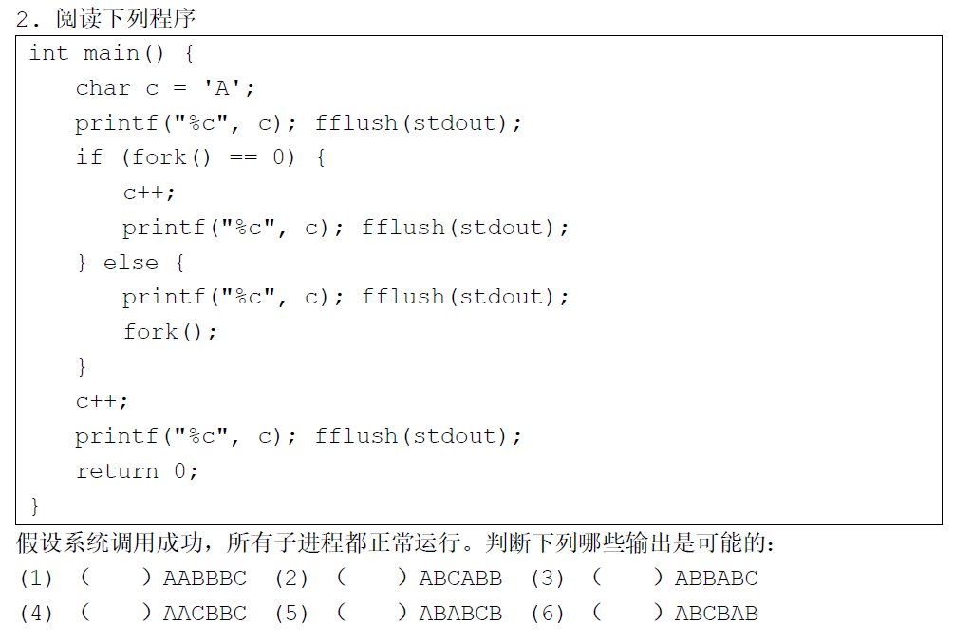
A
B
A
B
B
C
√
√
√

Slide 17
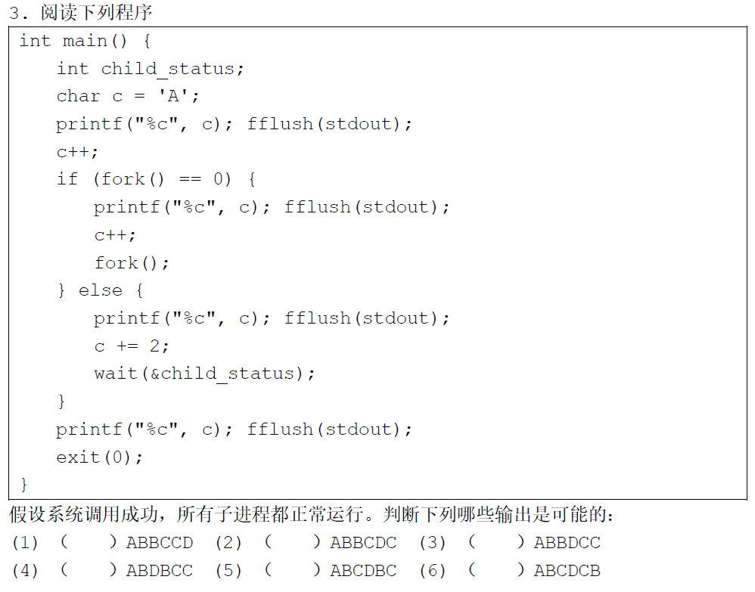
A
B
B
D
C
C
√
√

Slide 18
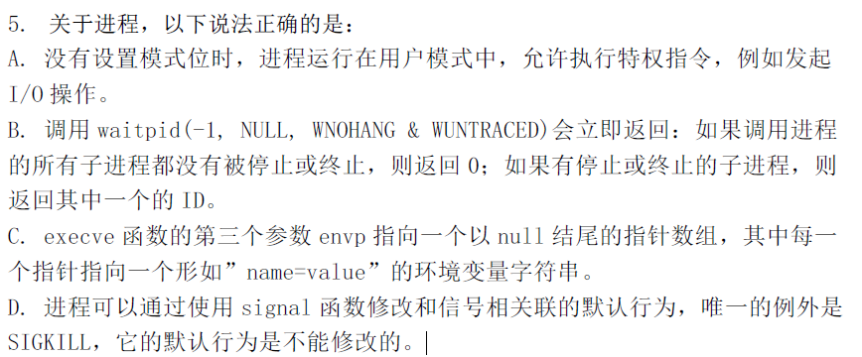
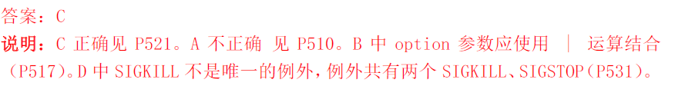

Slide 19
Case Study: 真实案例 #Live
在2018年的ICS课堂上，老师确实给同学布置了一个作业，在LINUX上写出一份代码，运行它以后，输出能创建的进程的最大数目。下面真的是几位同学的答案。
PART A. Alice同学的答案是：
int main() { int pid; int count = 1; while((pid = fork()) != 0){ // parent process count++; } if(pid == 0) { // child process exit(0); } printf("max = %d", count); }
现场演示走起～

Slide 20
IPC: Help processes communicate with each other
Signals / Pipes / Socket / Message queues / Semaphore / Moniter / Shared memory / …
What ICS cover: signal (Chapter 8), shared memory (Chapter 9), Semaphore (Chapter 12)

Slide 21
Signals
A small message that notifies a process that an event of some type has occurred in the system.
Triggered by system event or by user. E.g. From terminal,
> sleep 1000 &
[1] 271318
> kill -TERM 271318 # or %1
[1] + 271318 terminated sleep 1000
> man 7 signal and you can see a list of signals, triggering conditions and its default handler
The life of a signal (Cont.)
Delivery (aka sending): the kernel activates the corresponding bit in the signal bitmap. At this point of time, the signal is said to be pending. [If the bit is already on, the new signal is discarded. This is what we call the no queueing property, so do not use signal to count!]
You can see the ShdPnd (Pending), SigBlk (Blocked), SigIgn (Ignored), SigCgt (Caught) via the proc file system.
> cat /proc/<pid>/status | grep "Sig"

Slide 22
Signals
The life of a signal (Cont.)
Once the process is about to return from kernel mode to user mode (e.g. after a context switch), the kernel checks the signal bitmap. If there is one unmasked, it either handles it in a default way, in a user-defined way or just ignores it.
Upon this time, we said that the signal is received. (It is received only when it is unblocked)
Other minor issues:
Signals that cannot be ignored (namely SIGKILL and SIGSTOP) cannot be blocked.
To avoid infinite self-recurrency, the kernel blocks any pending signals of the type currently being processed by a handler. [Implicit blocking]
It is still possible to cause infinite loop. E.g. The code on the next slides.
Once a process is stopped (aka suspended, e.g., after Ctrl+Z sends a SIGTSTP), no signal except for SIGCONT and SIGKILL will be received until it is continued.
SIGCHLD is sent to the parent once its state is changed [Not only when it is terminated], namely when it exits, interrupted or resumes after being interrupted. So you must deal with SIGCHLD correctly in your sigchld_handler in tshlab.
Hint: waitpid(-1, &old_status, WNOTRACE | WCONTINUED | WNOHANG)

Slide 23
#include <signal.h>
#include <unistd.h>
void sig1_handler(int signum) {
kill(getpid(), SIGUSR2);
sleep(1);
write(1, "hello\n", 7);
}
void sig2_handler(int signum) {
kill(getpid(), SIGUSR1);
sleep(1);
write(1, "world\n", 7);
}
int main() {
signal(SIGUSR1, sig1_handler);
signal(SIGUSR2, sig2_handler);
kill(getpid(), SIGUSR1);
while (1);
}
Infinite loops
# One possible output
> ./a.out
world
hello
world
hello
world
hello
world
hello
world
hello
...

Slide 24
In-class Exercise
First let us walk through Exercise 8.23.
Write a program that forks two children, chld1 and chld2. Use only signals to print the pid of chld1 in chld2 and vice versa.
Do not use the function sigaction.
Hint: at most 2 signals suffices. To this end, you may use SIGUSR1 and SIGUSR2.
Crux: How to use signals to count a number? I.e. to send the pid of chld2 to chld1?

Slide 25
Buffer & Cache
缓冲 & 缓存
Cache is a smaller and fast memory component in the computer which is inserted between the CPU and the main memory. It is hardware-implemented.
Why cache works is two-fold:
Commonly-seen Locality
Memory Hierarchy [Speed, cost and storage]
Sets, lines, ways, direct mappings, set associativity.
Buffers are associated with a specific block device [mostly memory], and cover caching of filesystem metadata as well as tracking in-flight pages. It is software-implemented. It aggregates reads and writes of only several bytes to a few of several pages and thus saves the time.
TLB? Its name is most misleading. It is a cache, not a buffer, de facto.
If Memory Hierarchy never exists, cache will perish. But buffer still prevails.

Slide 26
Block Device vs Character Device
Most important features of block device:
Random access
Data can be fetched and processed in blocks
E.g. Memory, Disk
.. of character device:
The driver communicates by sending and receiving single characters
E.g. Keyboard
Buffers
Input buffer & output buffer:
What does scanf and printf do when it reads from keyboard or print to the screen?
The kernel generally does little or no buffering on character devices.
The kernel does a certain amount of buffering when reading from files in filesystems. [全缓冲]

Slide 27
Buffers
line-buffered: Flushed when the buffer is full or a ‘\xa’ (‘\n’) is encountered.
E.g. Keyboard, screen.
Buffered: Flushed when the buffer is full.
E.g. Files on disks
No buffer:
E.g. Stderr
Apart from these, when will a buffer be flushed?
fflush()
When the file is closed.
On exit() [Not _exit()] Examples is on the next slides

Slide 28
What is the difference?
#include <stdio.h>
#include <unistd.h>
int main() {
printf(”Hello ICS!");
exit(0);
}
> ./a.out
>
#include <stdio.h>
#include <unistd.h>
int main() {
printf(”Hello ICS!");
_exit(0);
}
> ./a.out
Hello ICS!>

Slide 29
Can you figure out why printf is not async-signal-safe while sprintf is even recurrent in the glibc?
printf has a global locking scheme...
Suppose that the main program is in the middle of a call to a stdio function such as printf(3) where the buffer and associated variables have been partially updated. If, at that moment, the program is interrupted by a signal handler that also calls printf(3), then the second call to printf(3) will operate on inconsistent data, with unpredictable results.
From > man signal-safety
sprintf uses only local variables and status.
[Not specified in the standard though.]

Slide 30
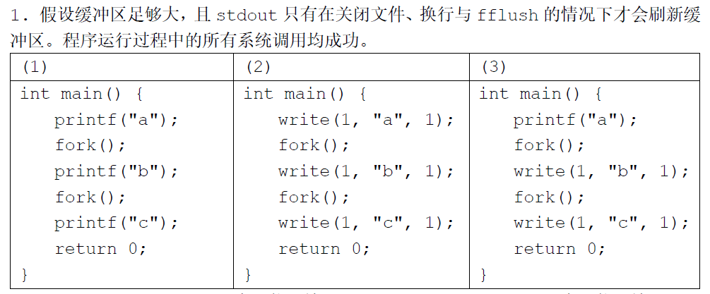
c c
c c
a
a
b
b
a
b
a
b
abcabcabcabc

Slide 31
c
b
c
a
b
c
c

Slide 32
c
a
a
b
c
a
a
b
c
a
a
c
a

Slide 33
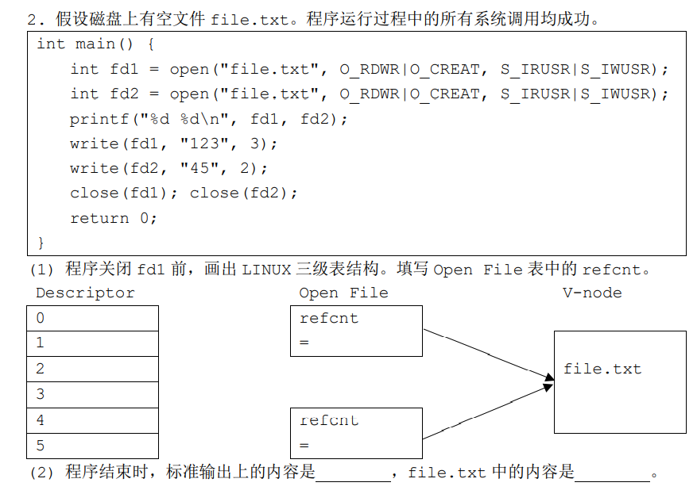
1
1
3 4
453

Slide 34
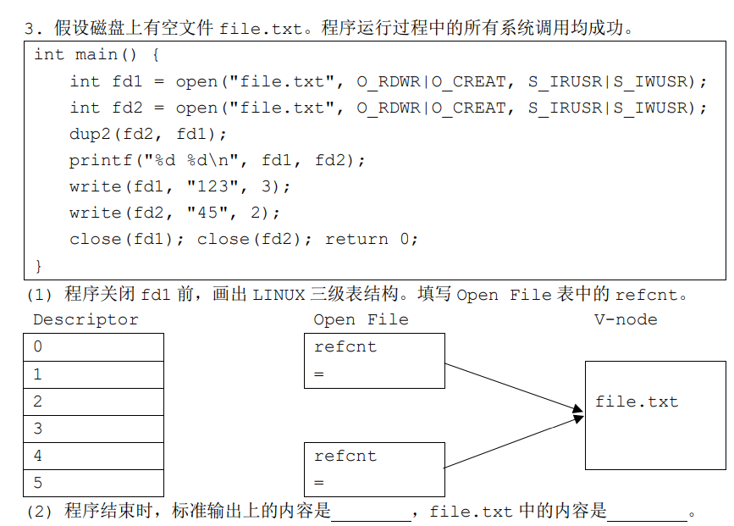
1
2
1
3 4
12345

Slide 35
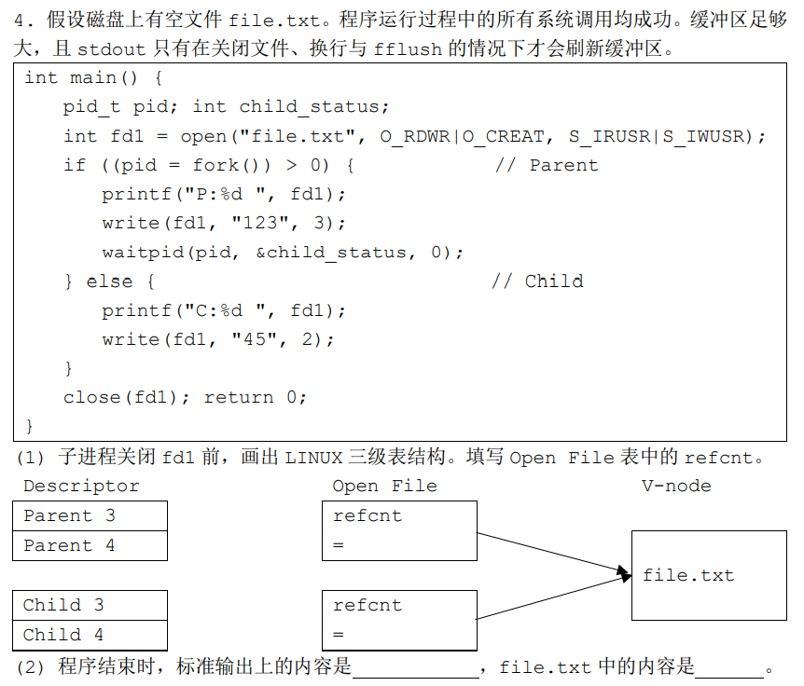
2
1
12345
或45123
C:3 P:3

Slide 36
往年题 1

Slide 37
#include <stdio.h>
#include <stdlib.h>
#include <unistd.h>
#include <signal.h>
int c = 1;
void handler1(int sig) {
c++;
printf("%d", c);
}
int main() {
signal(SIGUSR1, handler1);
sigset_t s;
sigemptyset(&s);
sigaddset(&s, SIGUSR1);
sigprocmask(SIG_BLOCK, &s, 0);
int pid = fork()?fork():fork();
if (pid == 0) {
kill(getppid(), SIGUSR1); printf("S");
sigprocmask(SIG_UNBLOCK, &s, 0); exit(0);
} else {
while (waitpid(-1, NULL, 0) != -1); sigprocmask(SIG_UNBLOCK, &s, 0);
printf("P");
}
return 0;
}
这段代码有几种可能的输出？
Hint: 官答的结果是错的。

Slide 38
往年题 2

Slide 39
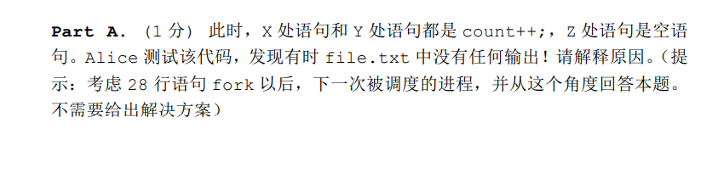
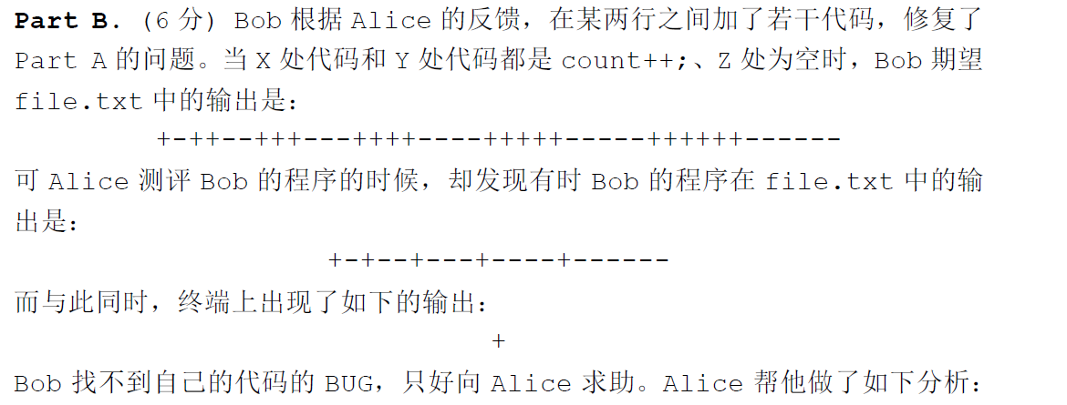

Slide 40
-
+ | +
 | - | -
 |  | + | + | +
 |  |  | - | - | -
 |  |  |  |  | + | + | + | +
 |  |  |  |  |  | - | - | - | -
 |  |  |  |  |  |  |  |  | + | + | + | + | +
 |  |  |  |  |  |  |  |  |  | - | - | - | - | -
 |  |  |  |  |  |  |  |  |  |  |  |  |  | + | + | + | + | + | +
 |  |  |  |  |  |  |  |  |  |  |  |  |  |  | - | - | - | - | - | -
+ | - | + | - | - | + | - | - | - | + | - | - | - | - | + | - | - | - | - | - | -

Slide 41
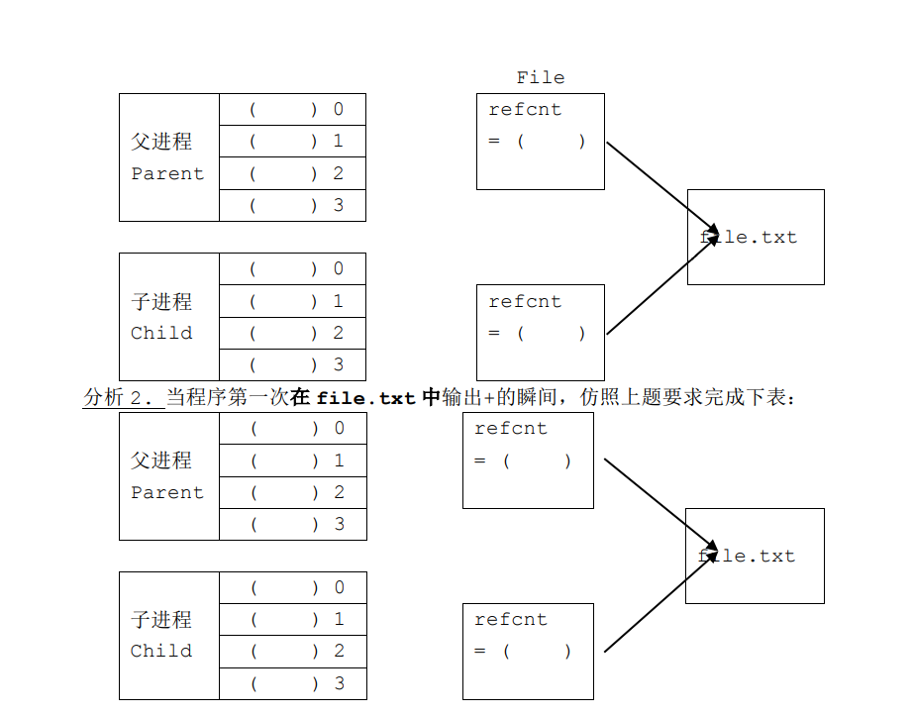

Slide 42
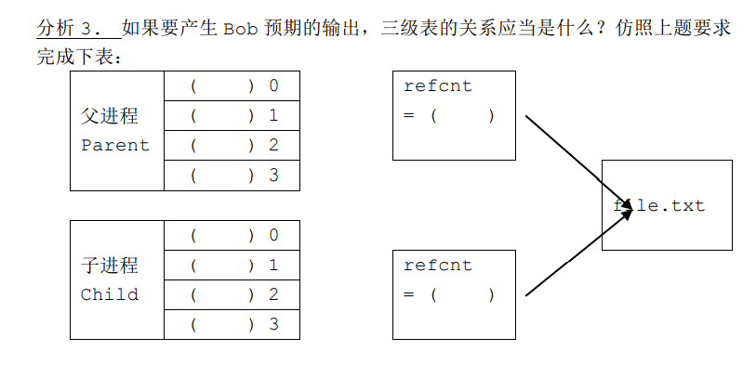

Slide 43
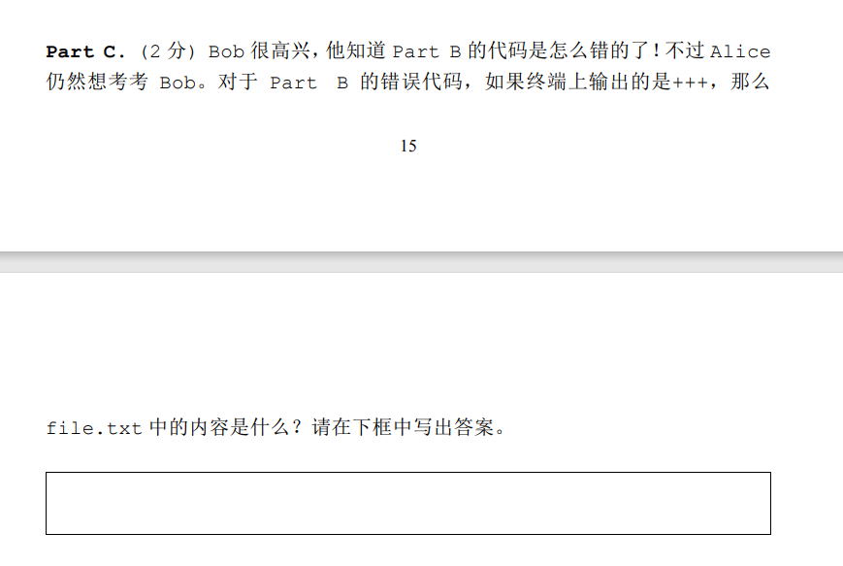
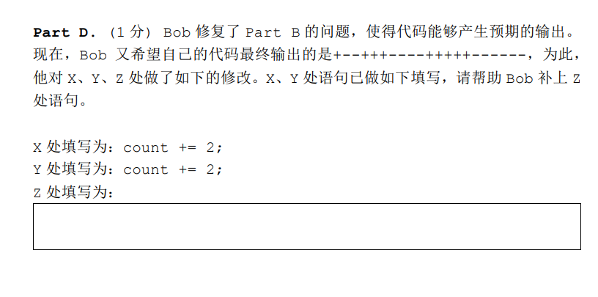
++++++-+++--+++------􀀈(6+1-3+2-3+6-)
count = 2;
任何把 count 初始化为 2 的语句都行

Slide 44
演示：进程实现的素数筛

Slide 45
Any questions?

